Slide 1
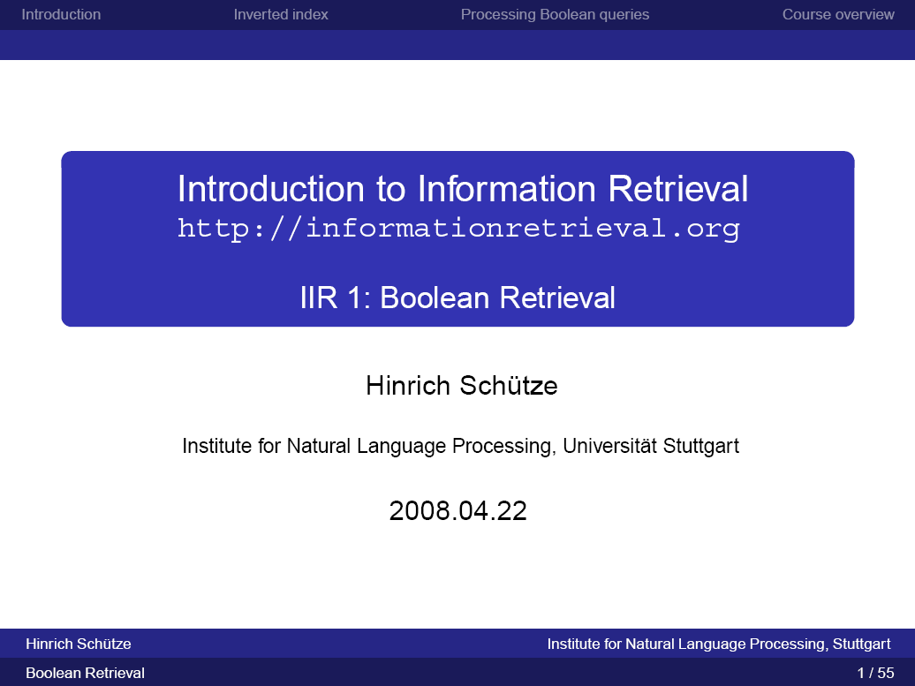

Slide 2
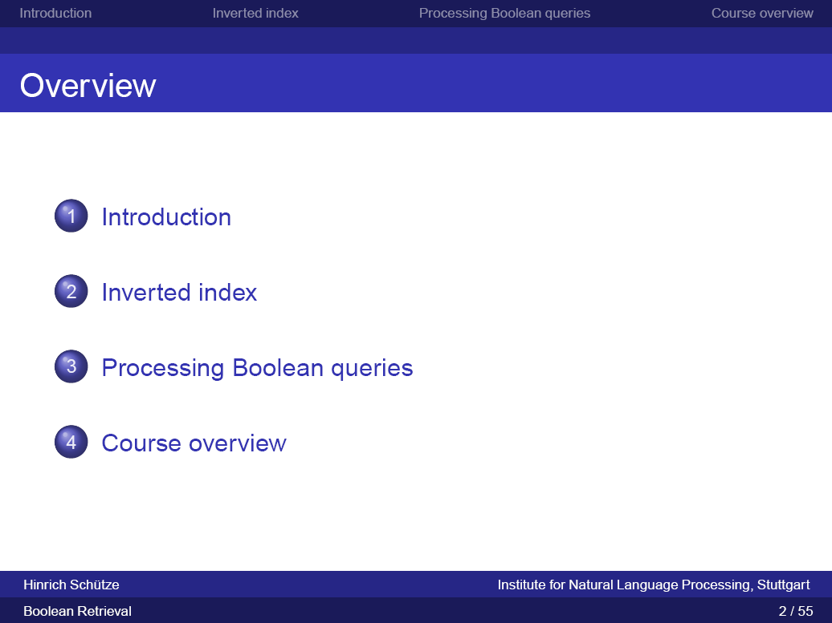

Slide 3
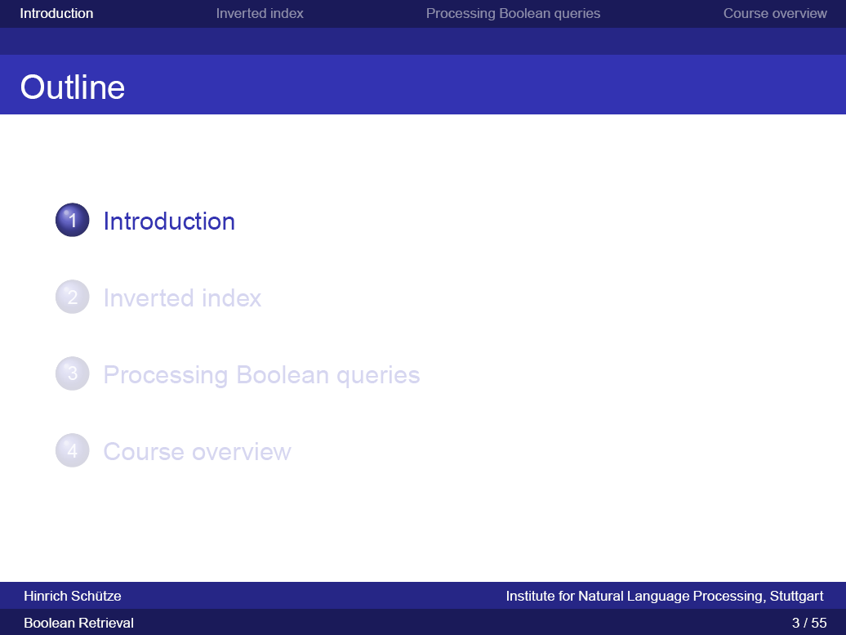

Slide 4
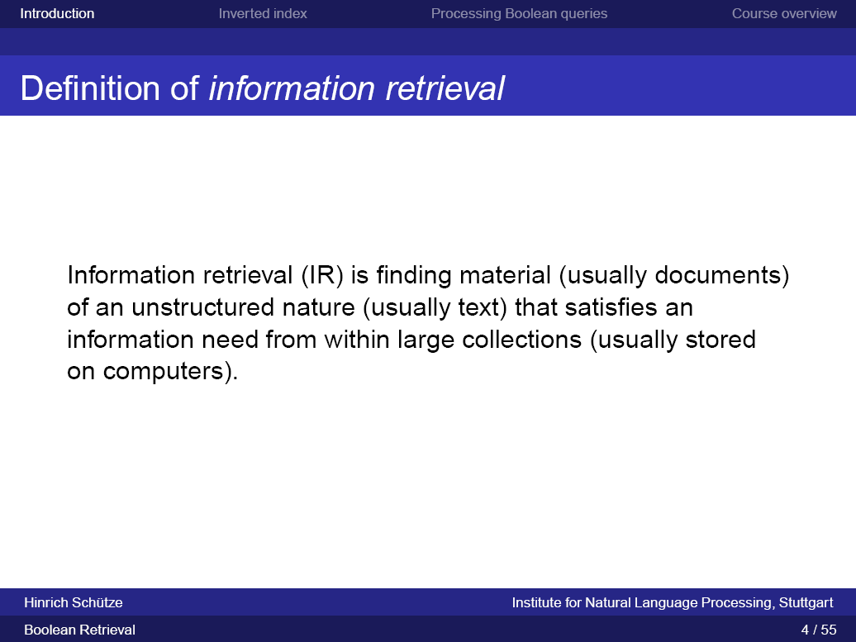

Slide 5
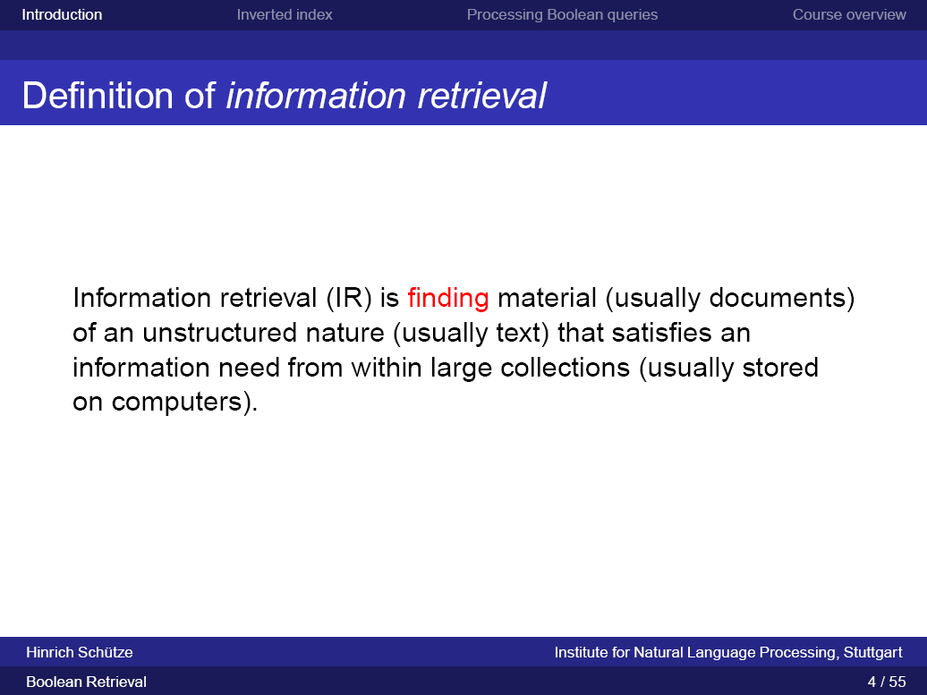

Slide 6
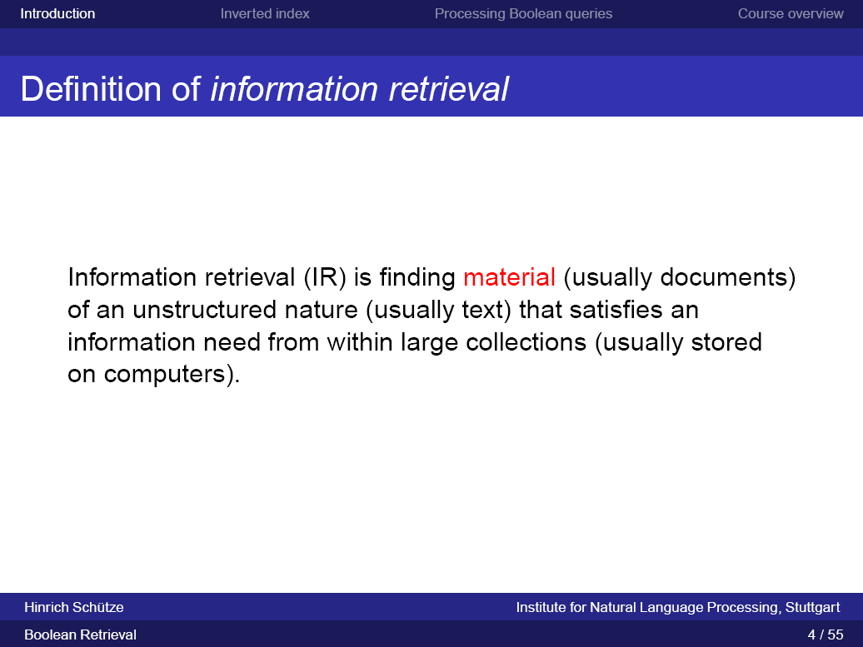

Slide 7
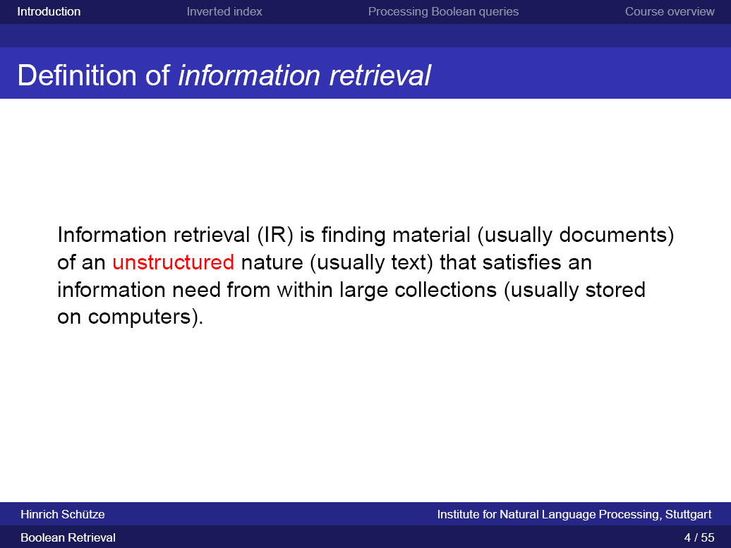

Slide 8
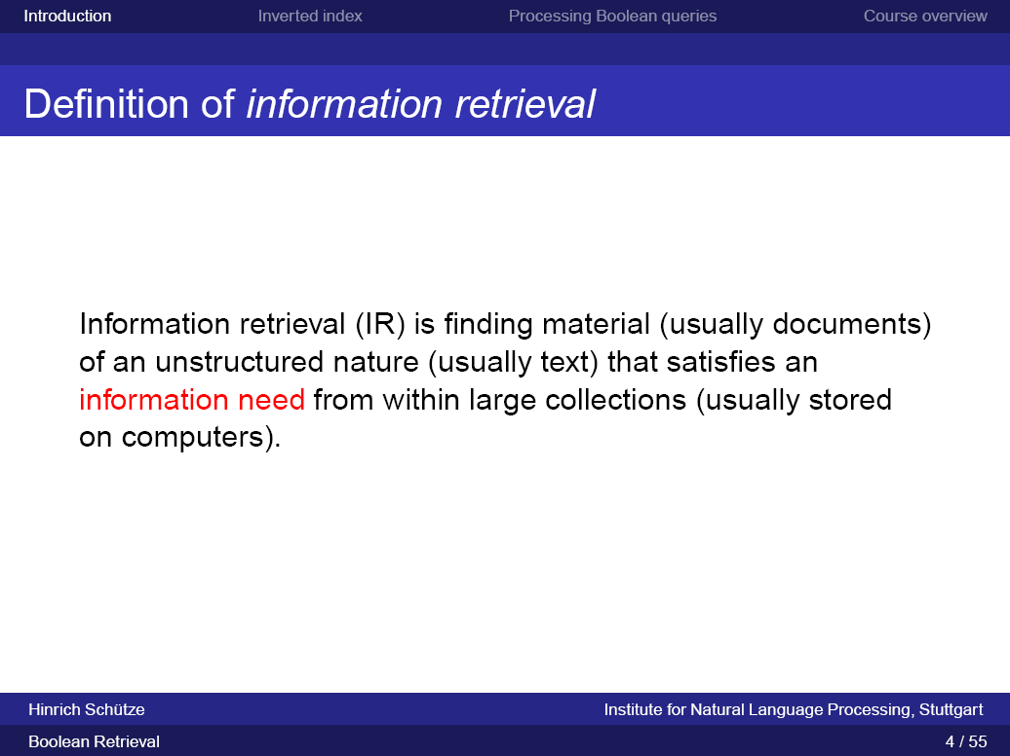

Slide 9
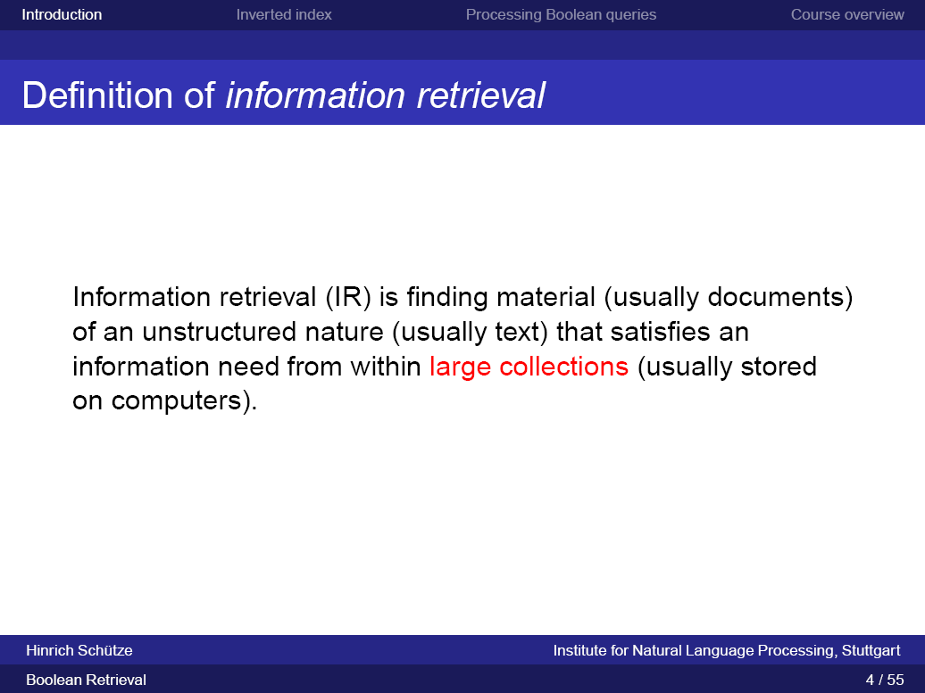

Slide 10
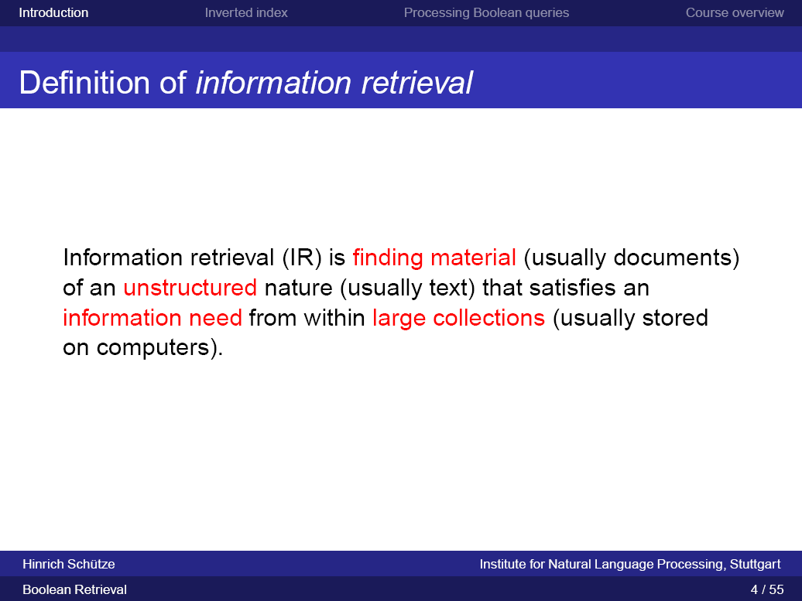

Slide 11
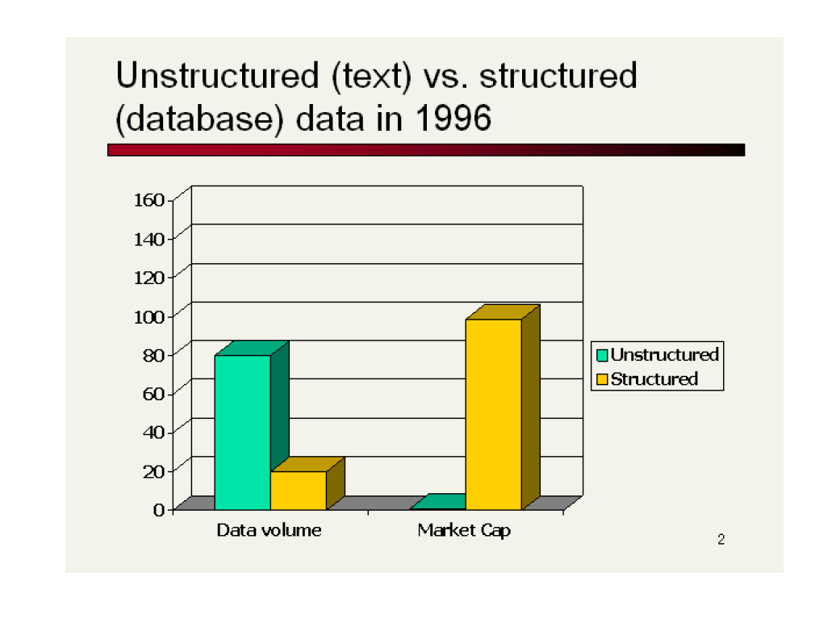

Slide 13
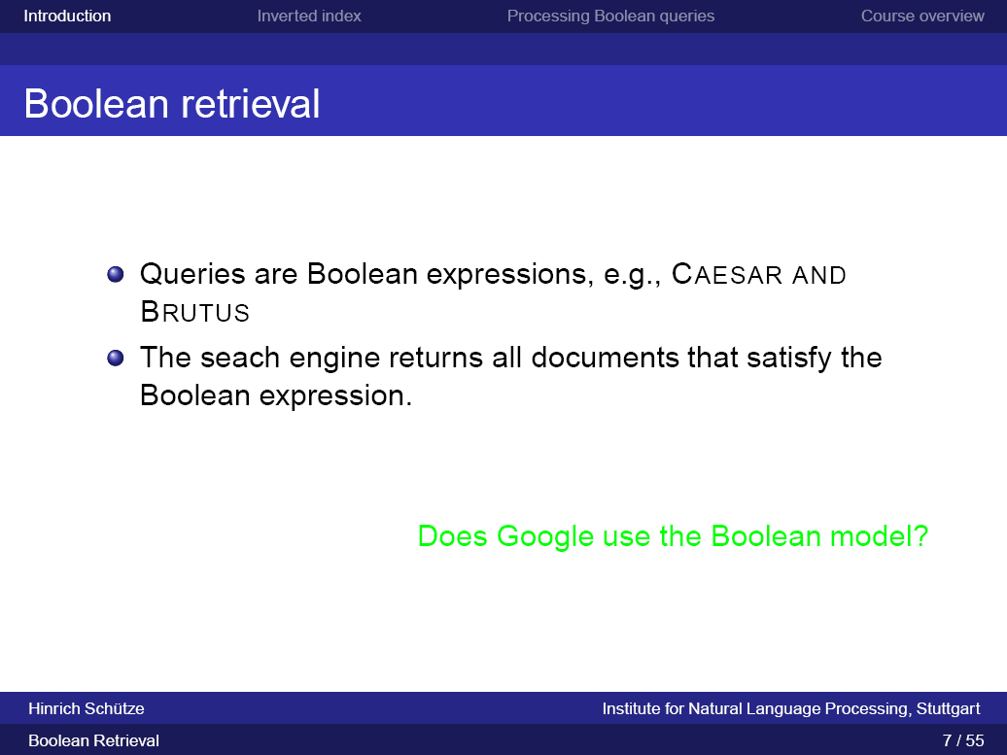

Slide 14
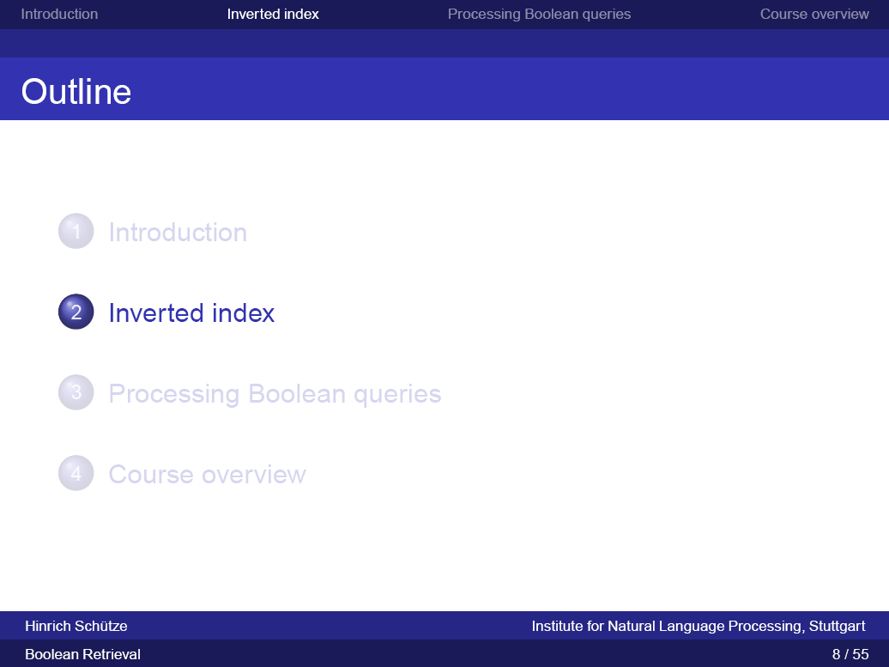

Slide 15
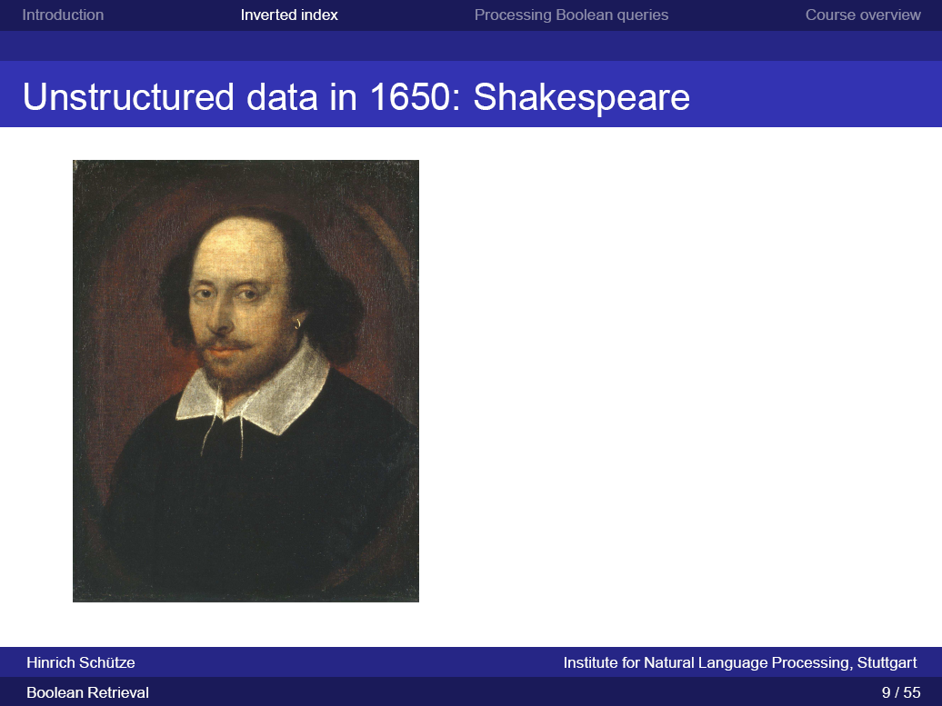

Slide 16
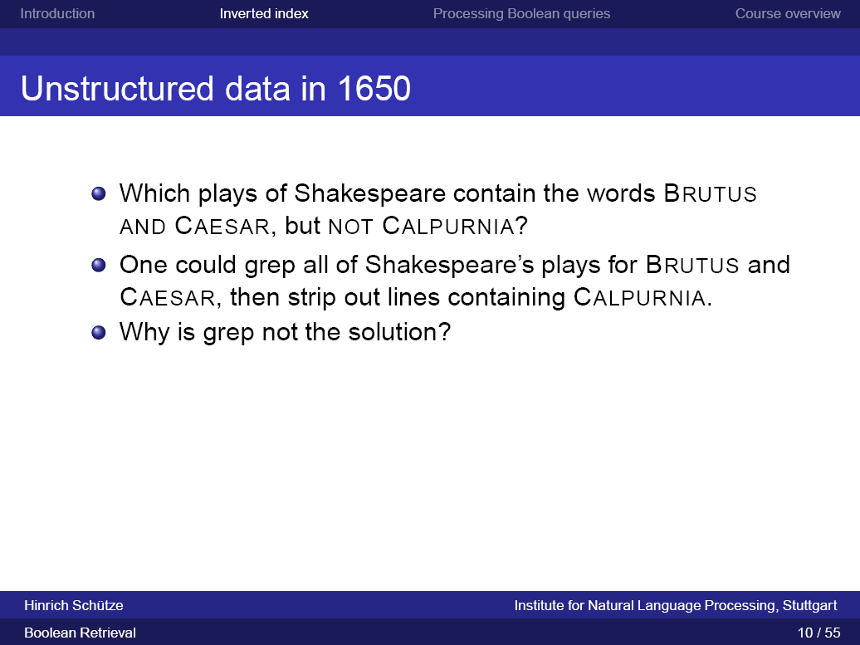

Slide 17
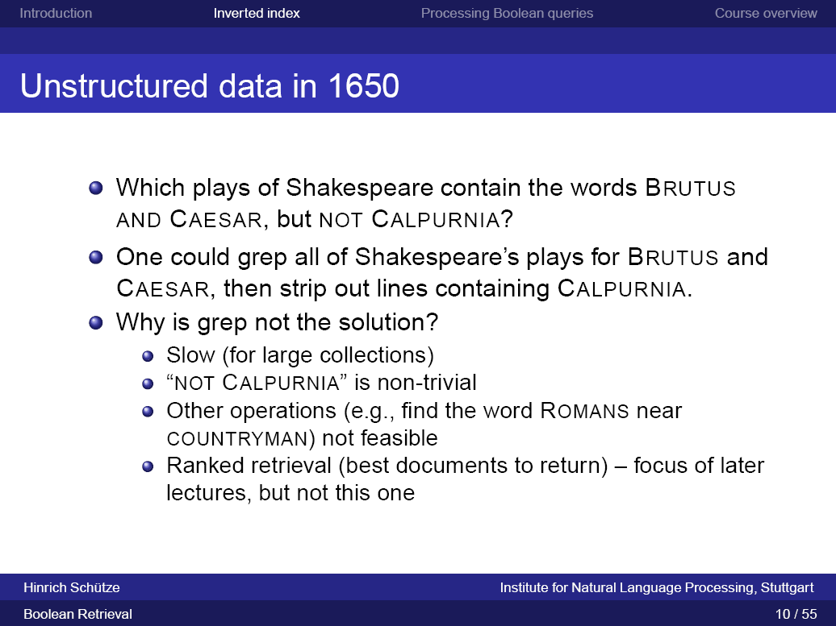

Slide 18
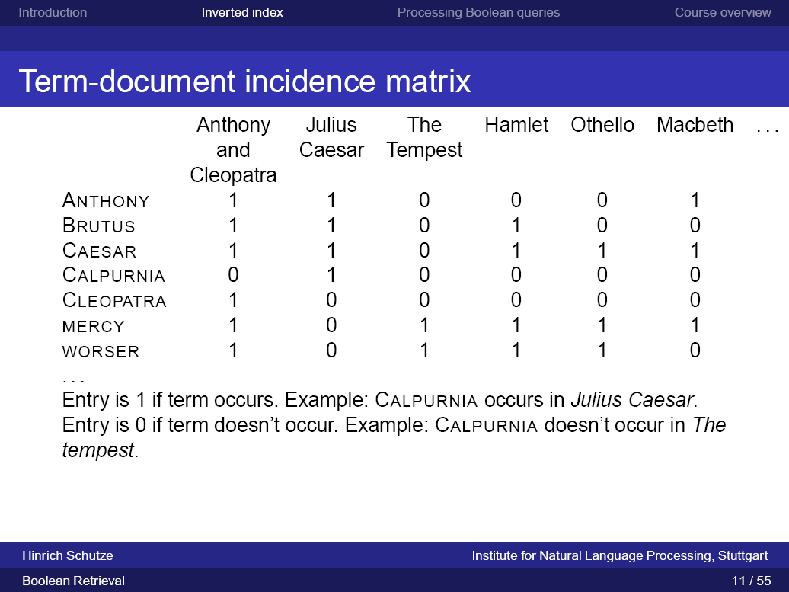

Slide 19
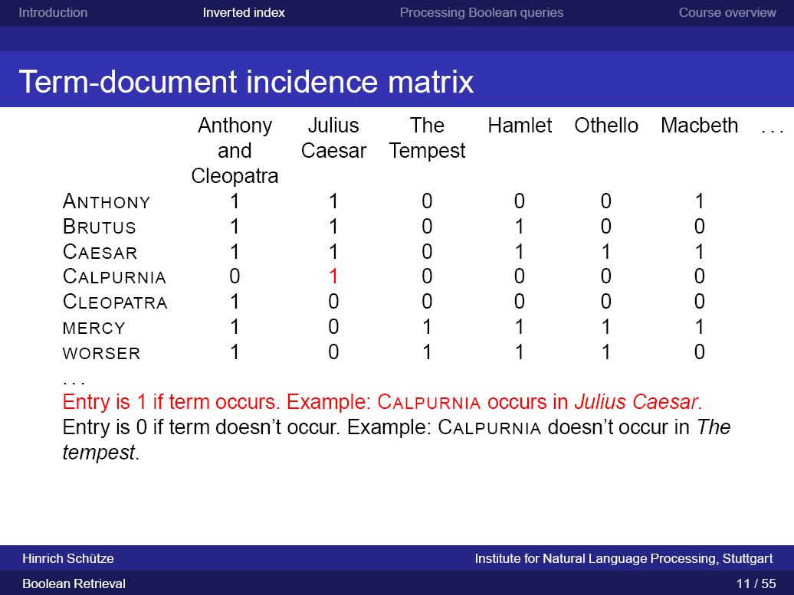

Slide 20
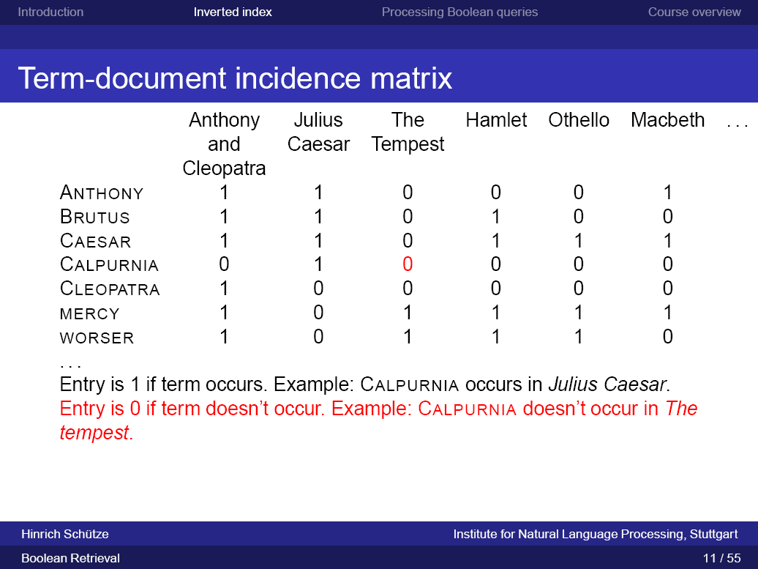

Slide 21
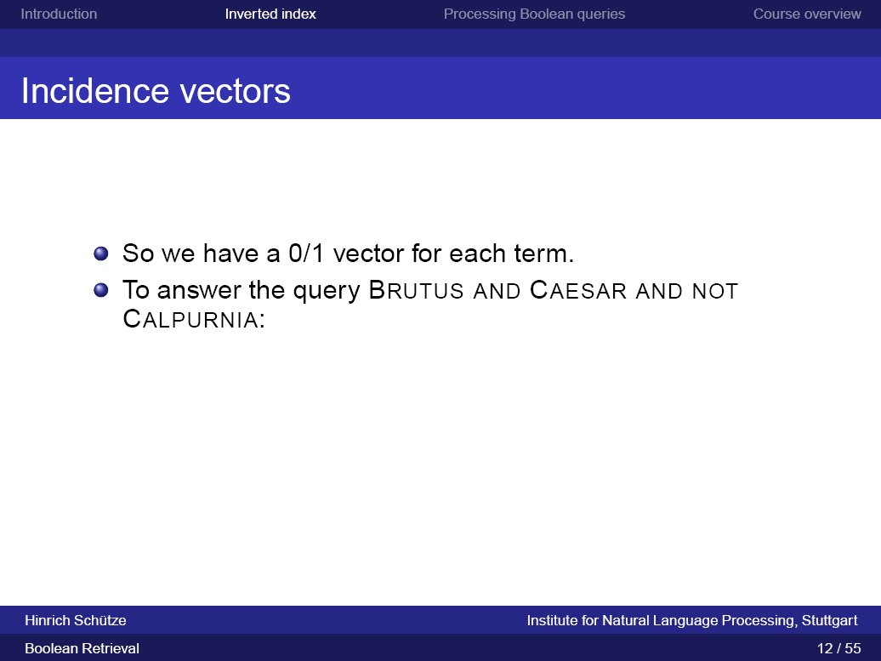

Slide 23
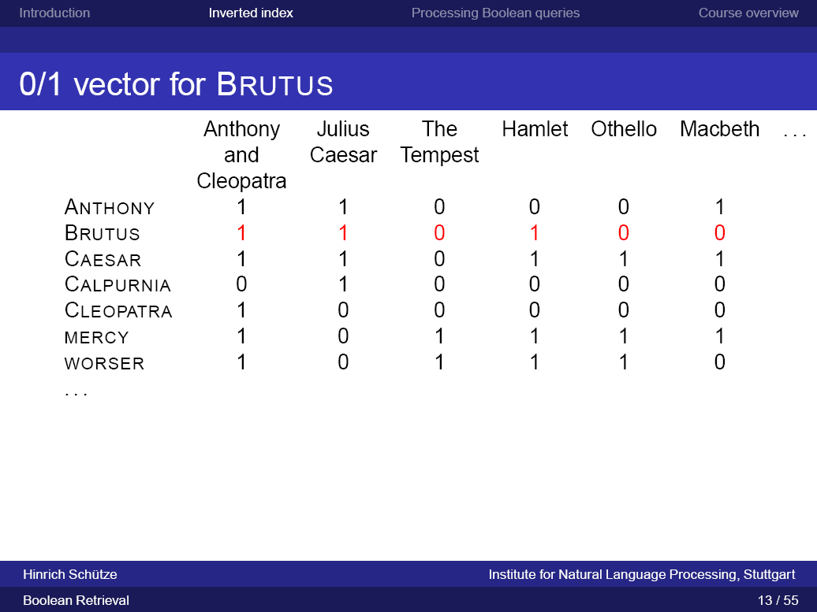

Slide 24


Slide 25


Slide 26
To answer the query Brutus AND Caesar AND NOT Calpurnia, we take the
vectors for Brutus, Caesar and Calpurnia, complement the last, and then do a
bitwise AND:
110100 AND 110111 AND 101111 = 100100
The answers for this query are thus Antony and Cleopatra and Hamlet

Slide 27
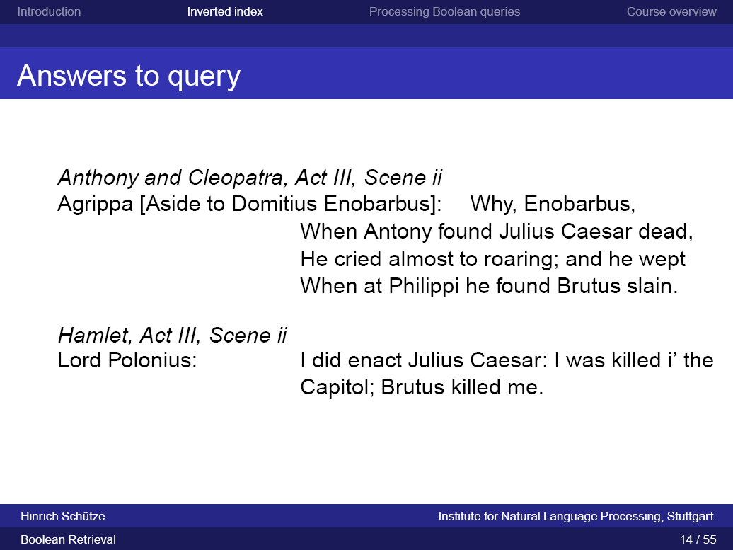

Slide 28
The Boolean retrieval model is a model for information BOOLEAN RETRIEVAL retrieval in which we MODEL can pose any query which is in the form of a Boolean expression of terms,
that is, in which terms are combined with the operators AND, OR, and NOT.
The model views each document as just a set of words.

Slide 29
Let us now consider a more realistic scenario, simultaneously using the opportunity to introduce some terminology and notation.
Suppose we have N = 1 million documents.
By documents we mean whatever units we have decided to build a retrieval system over.
They might be individual memos or chapters of a book.
We will refer to the group of documents over which we perform retrieval as the (document) collection. It is sometimes also referred to as a corpus (a body of texts). Suppose each document is about 1000 words long (2–3 book pages).

Slide 30
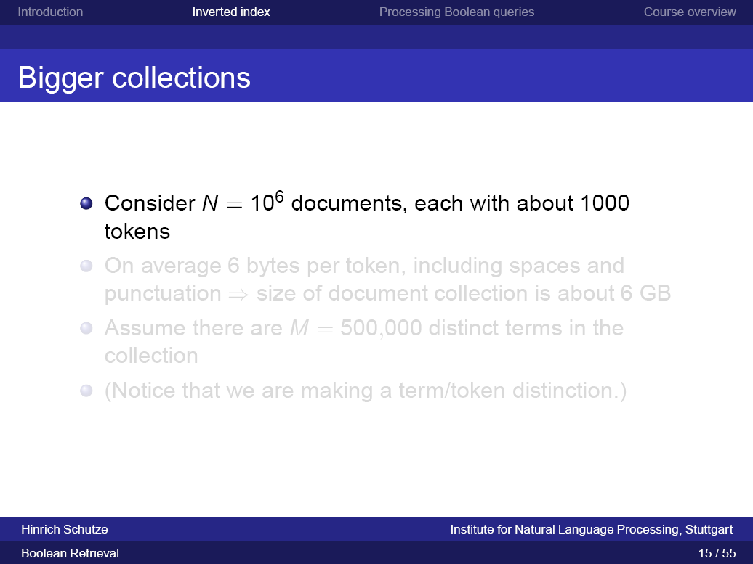

Slide 31
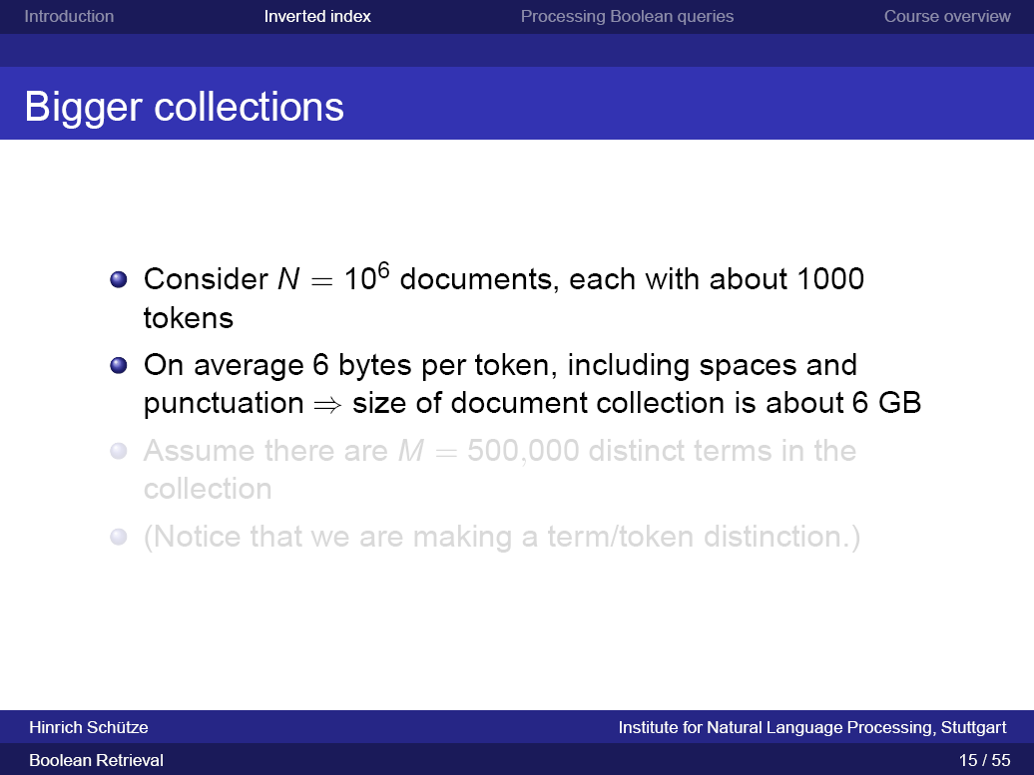

Slide 32
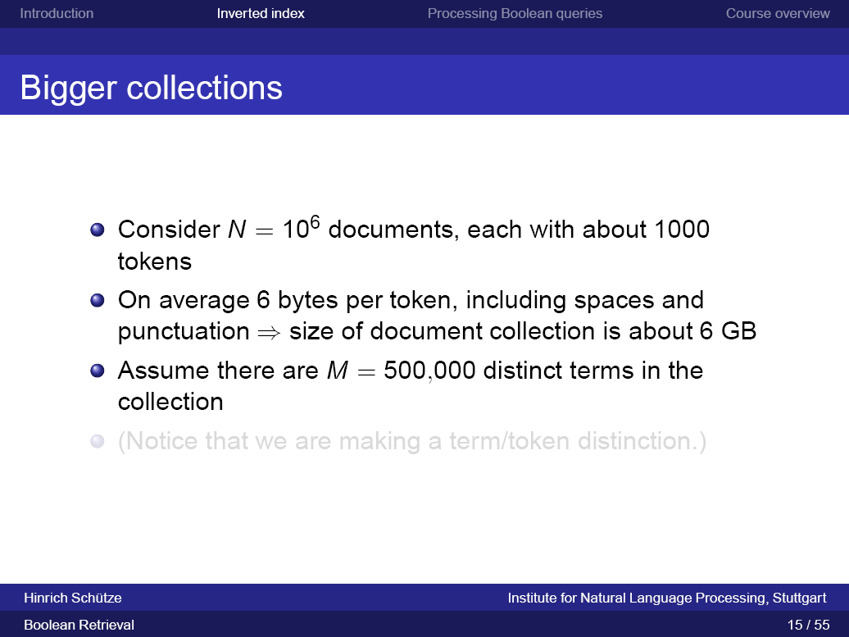

Slide 33
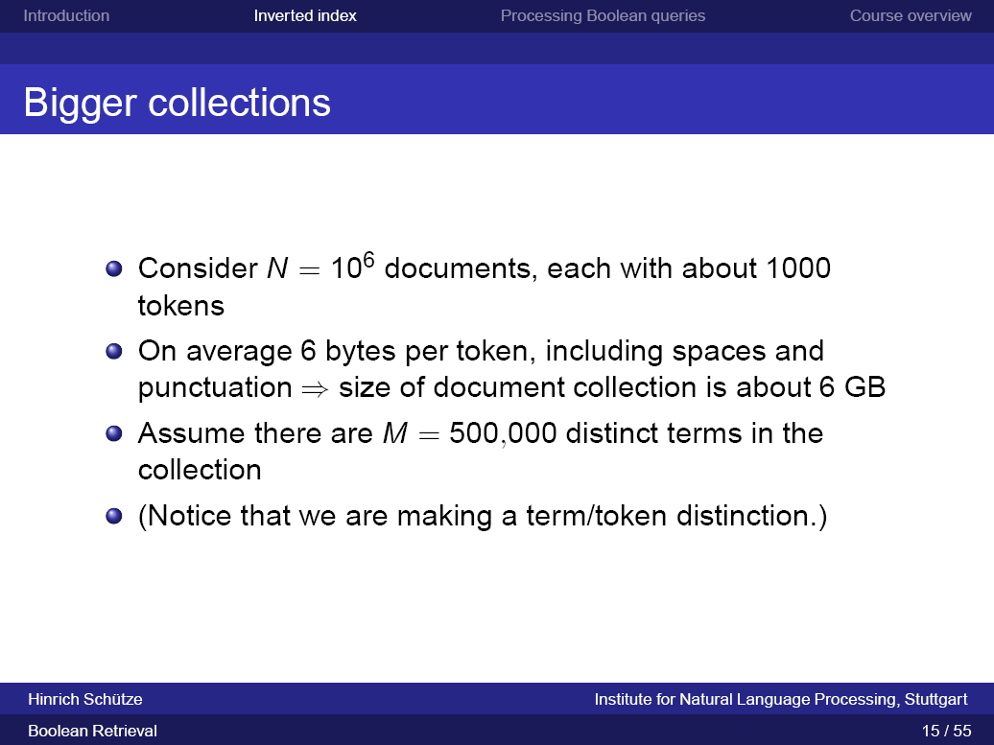

Slide 34
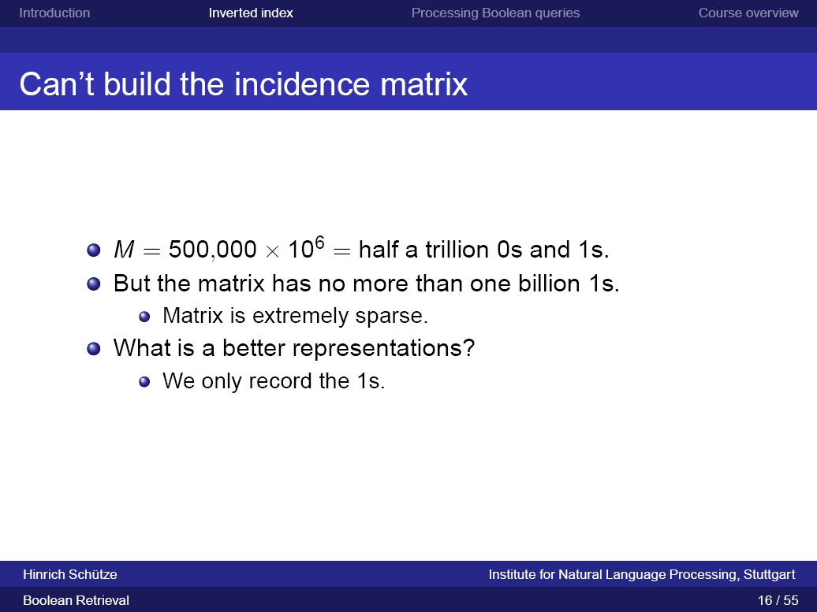

Slide 35
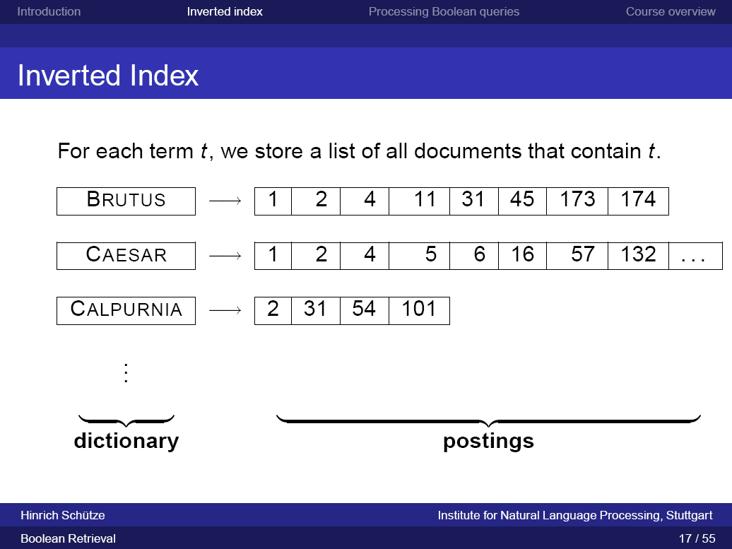

Slide 36
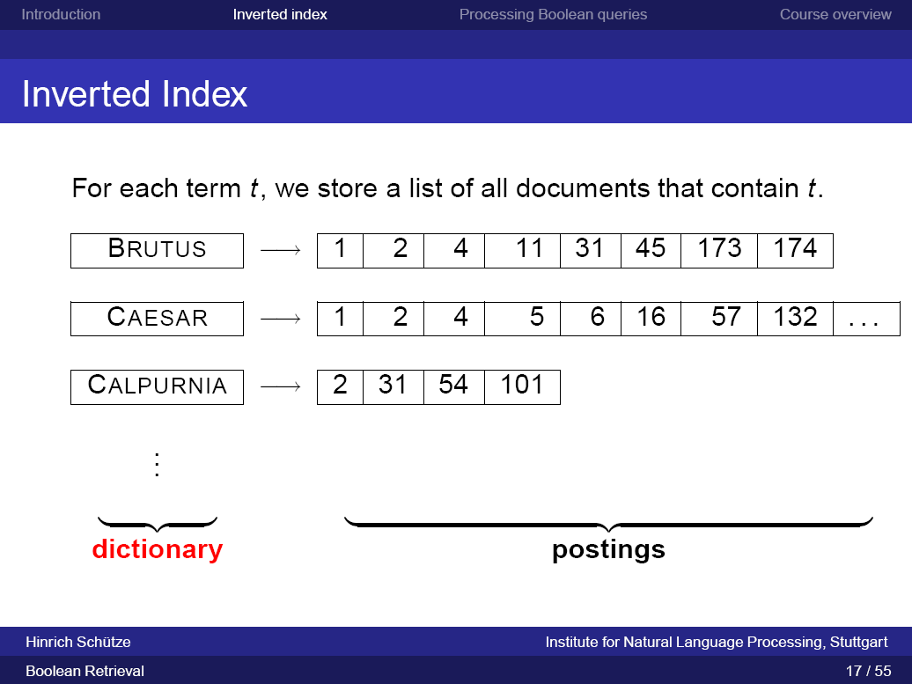

Slide 37
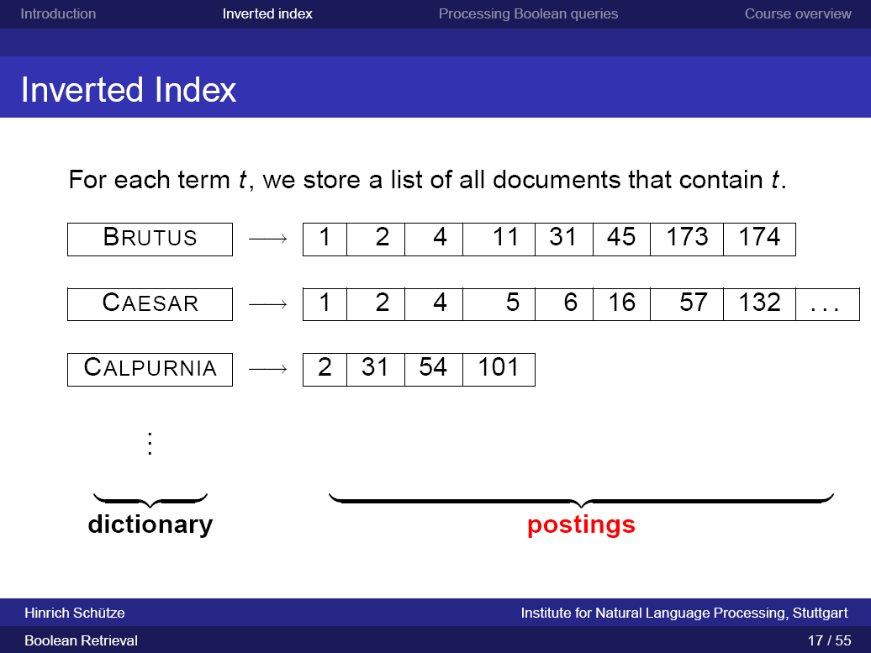

Slide 38
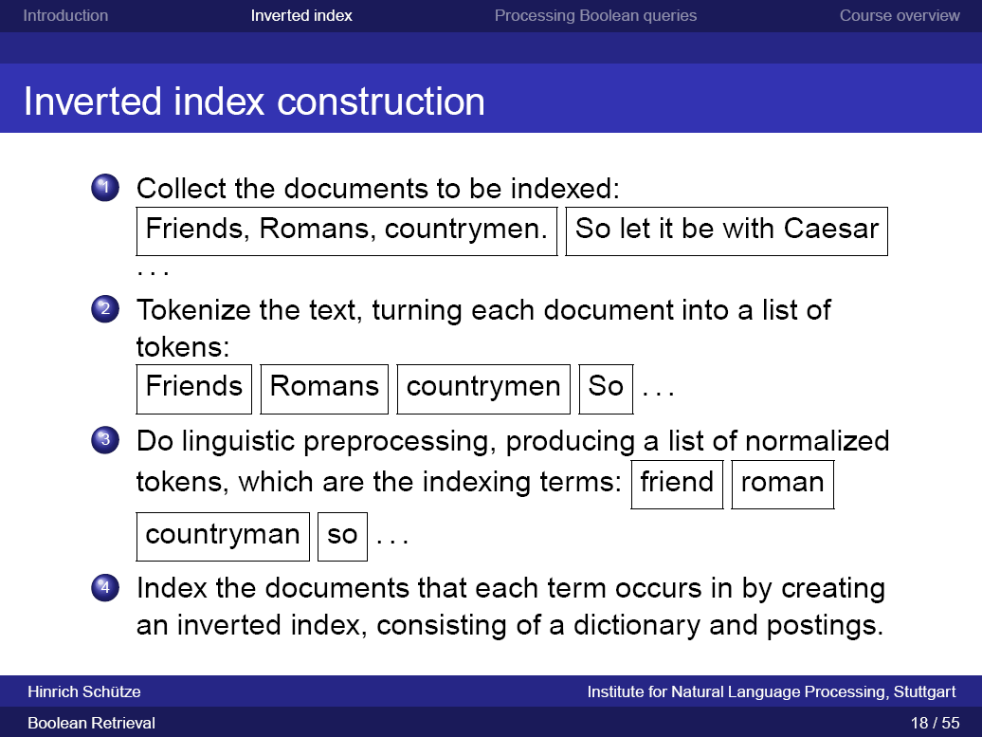

Slide 39
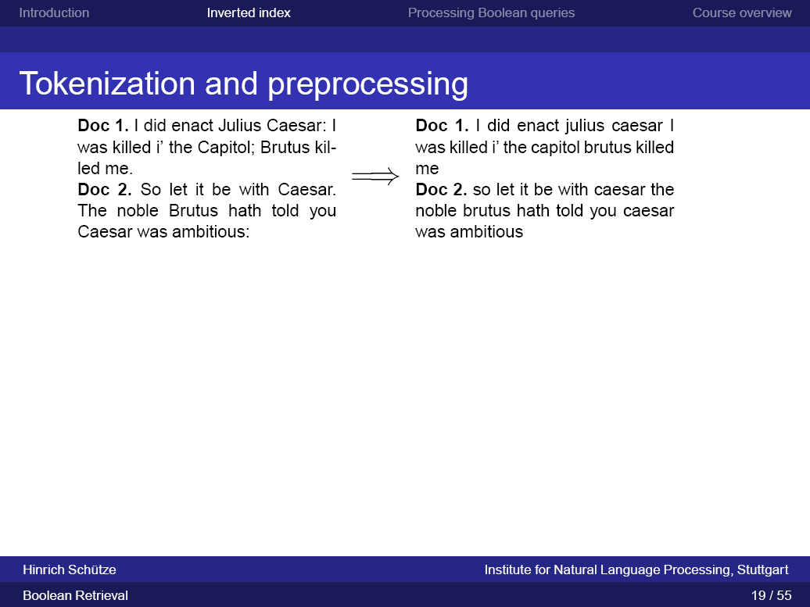

Slide 41
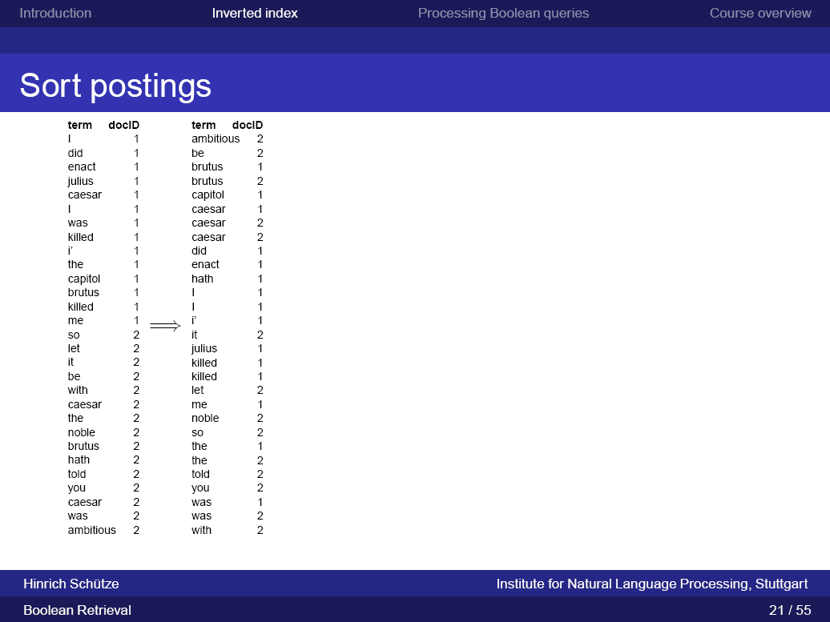

Slide 42
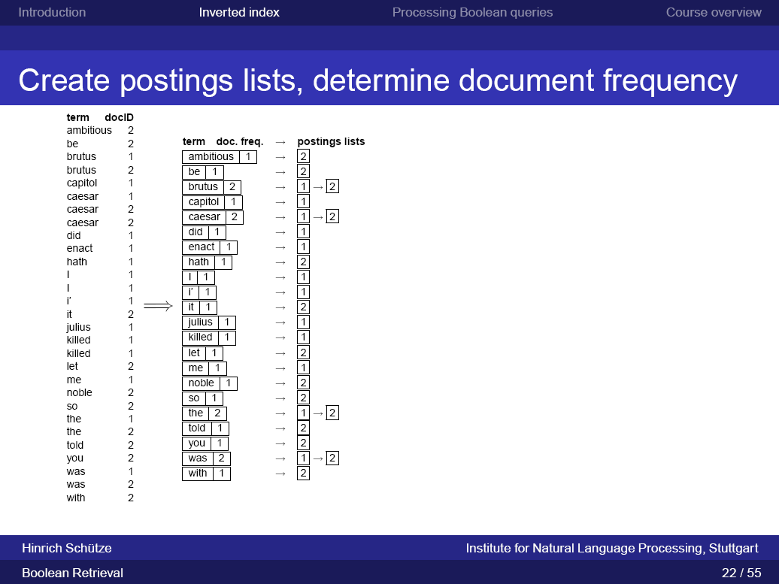

Slide 43
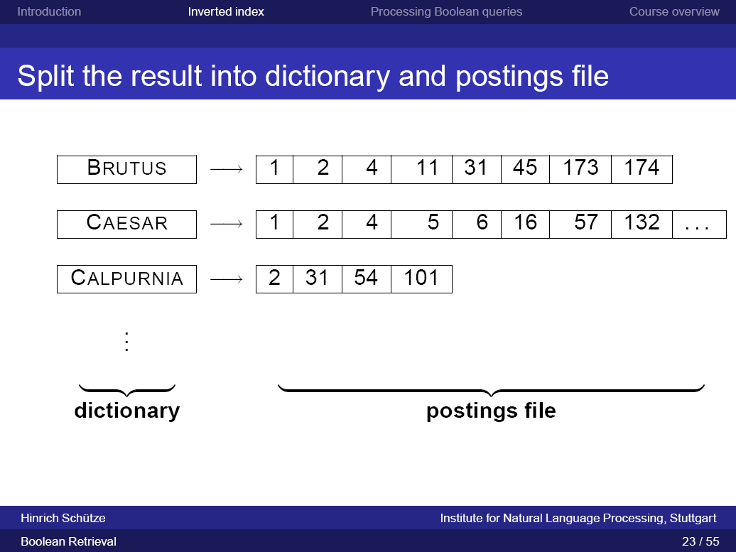

Slide 44
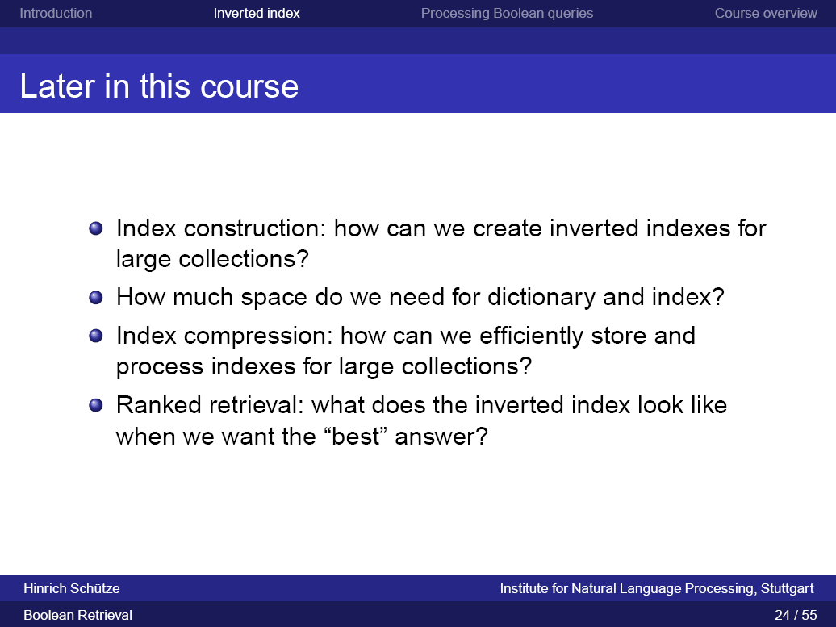

Slide 45
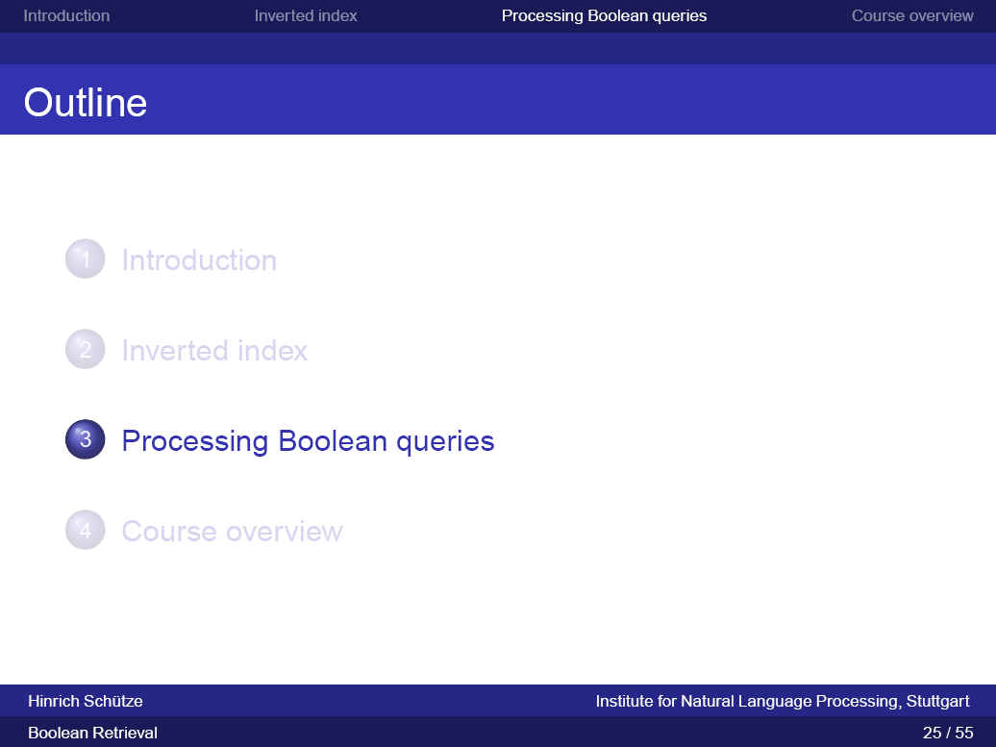

Slide 46
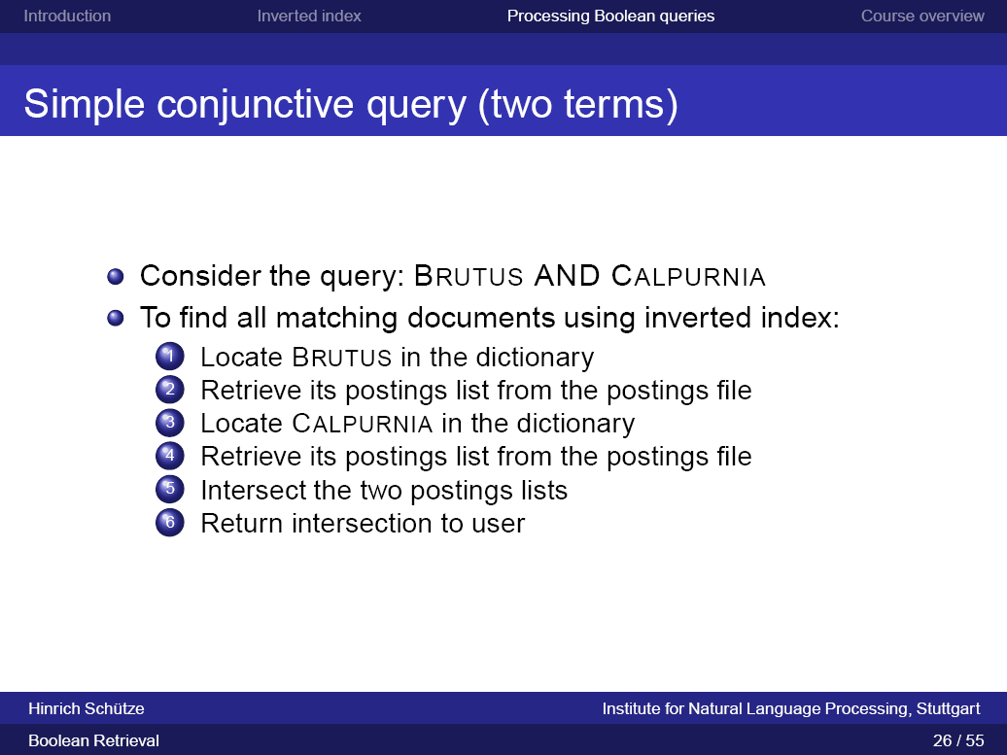

Slide 47
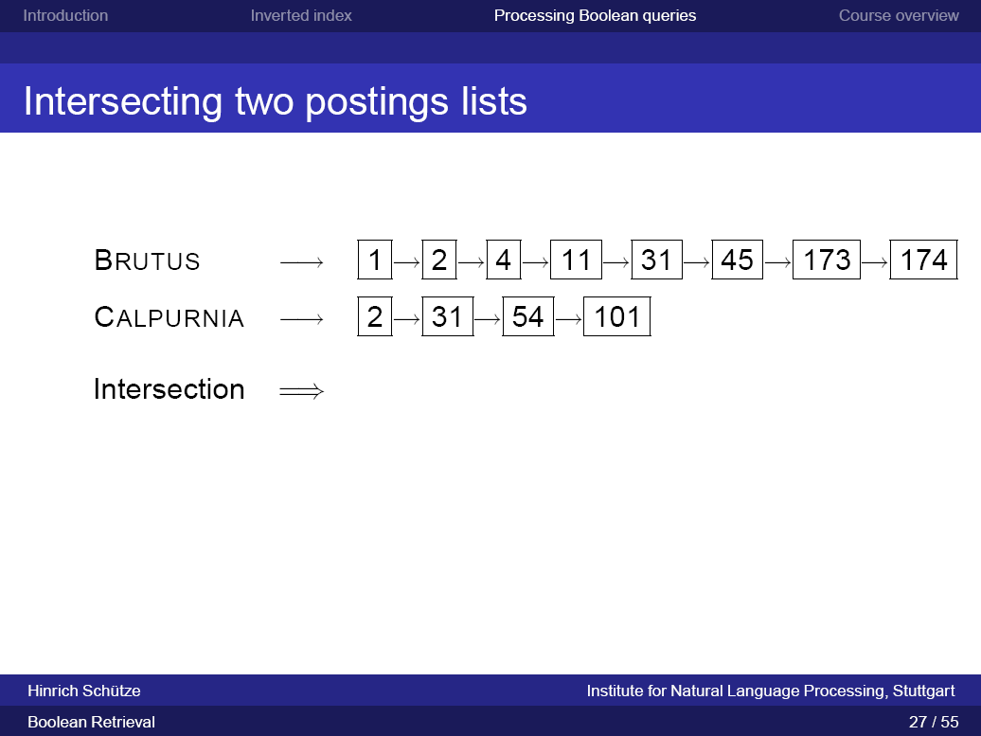

Slide 48
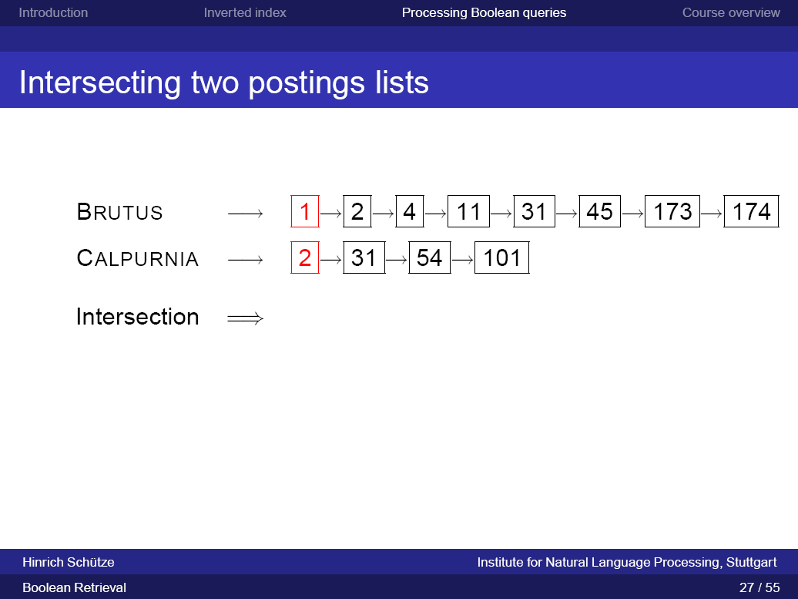

Slide 49
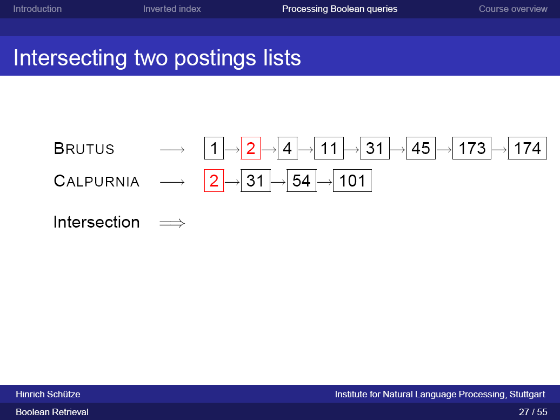

Slide 51
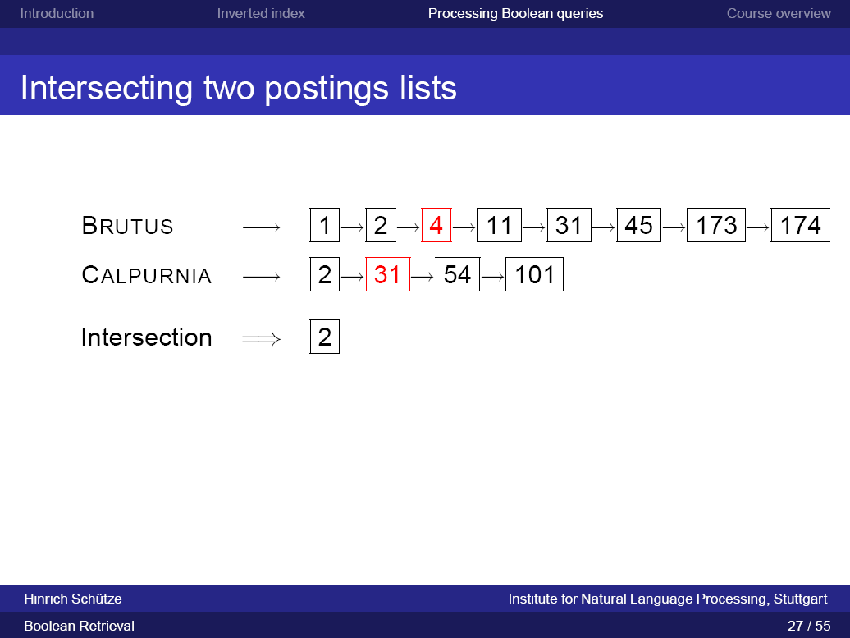

Slide 52
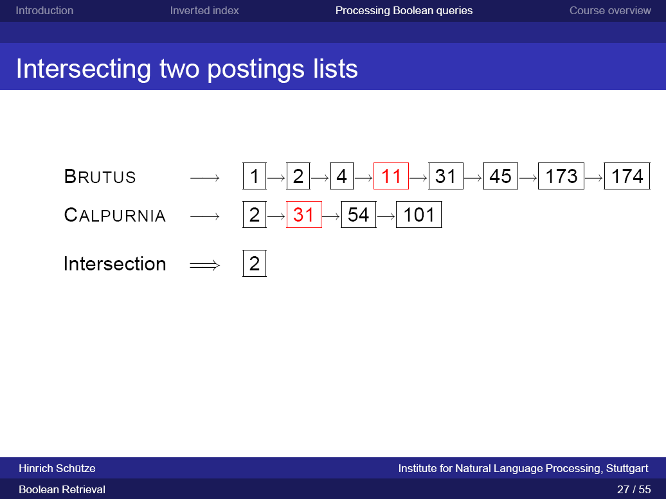

Slide 53
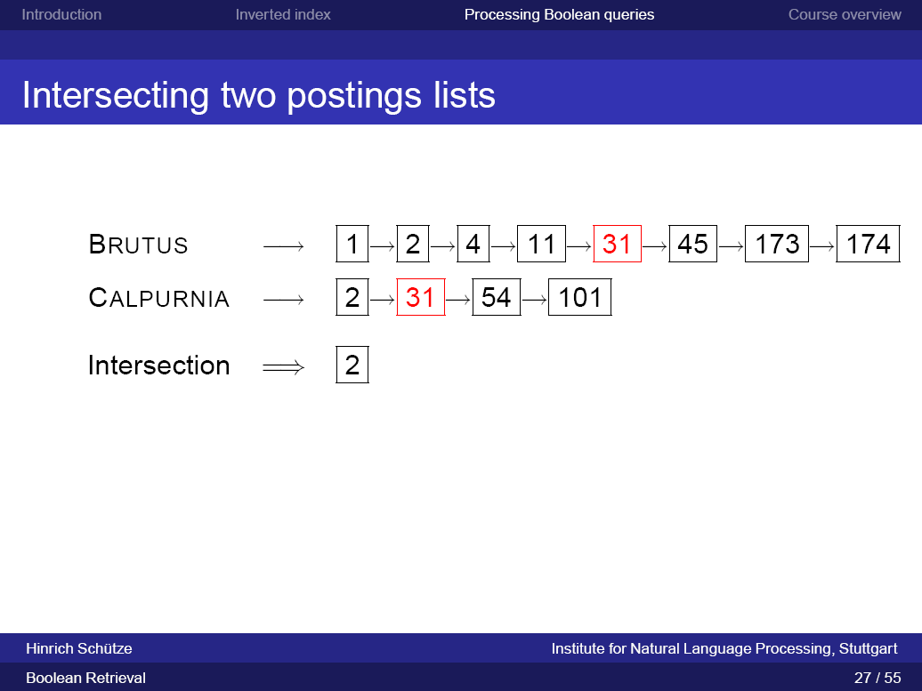

Slide 54
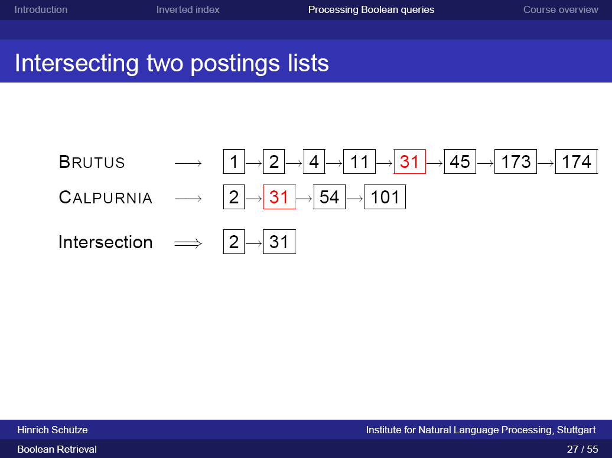

Slide 55
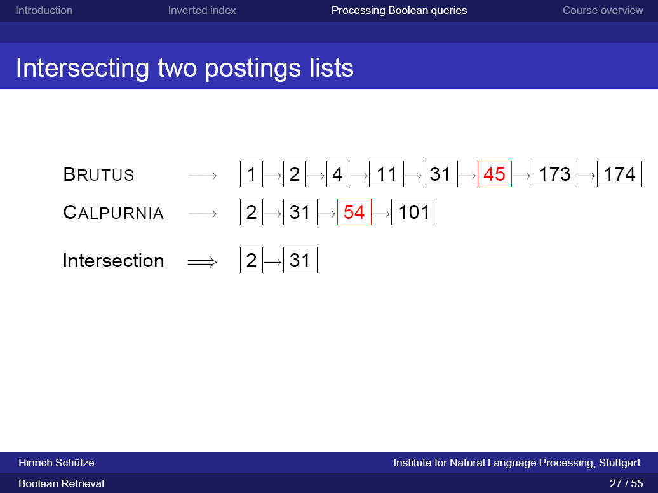

Slide 56
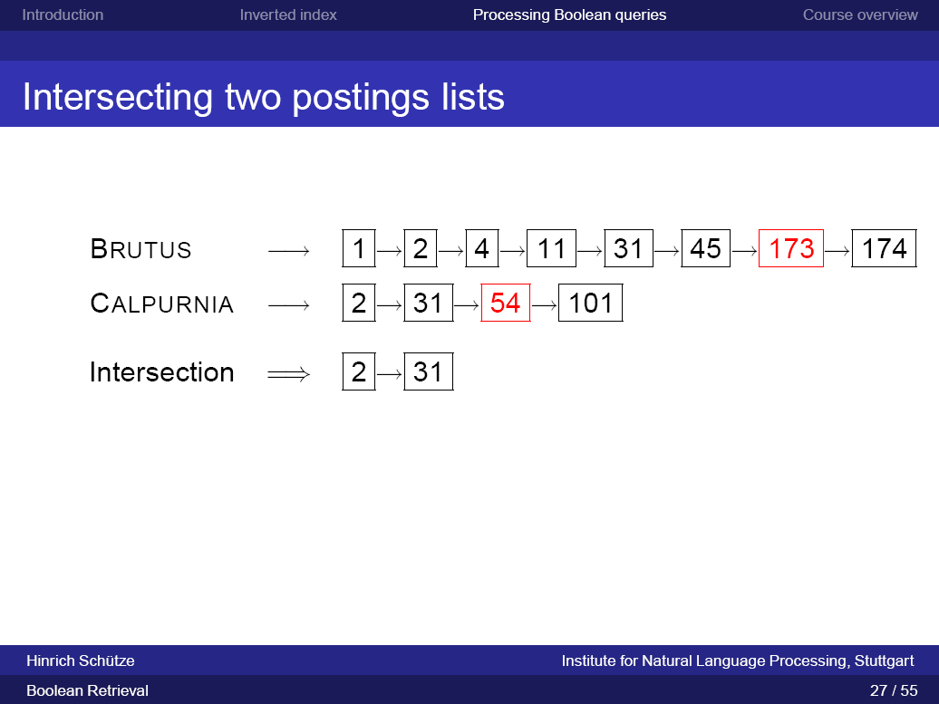

Slide 57
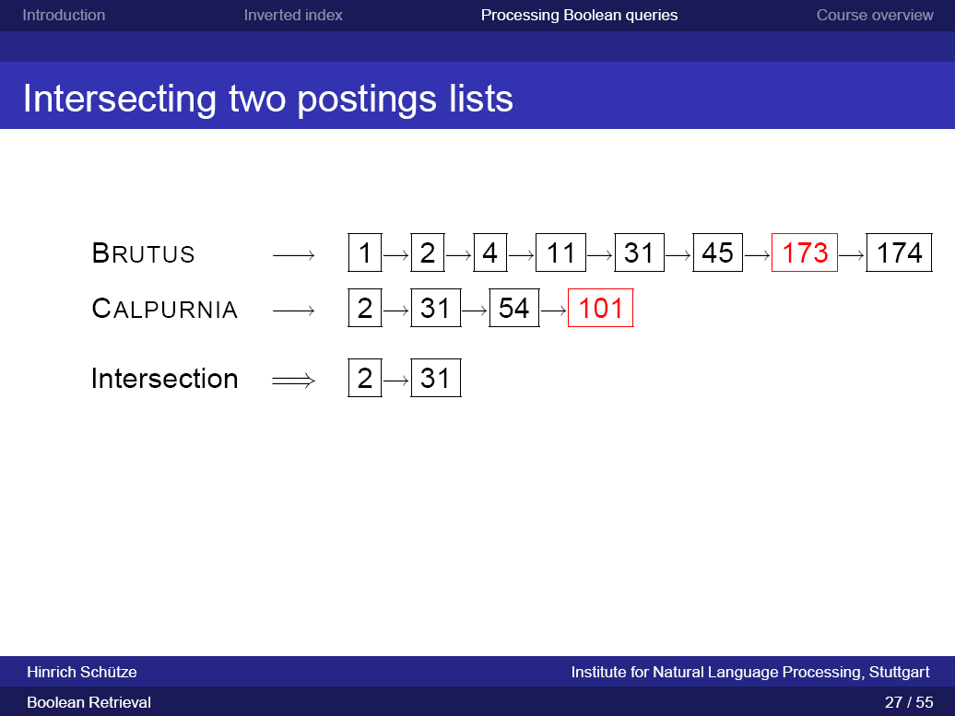

Slide 58
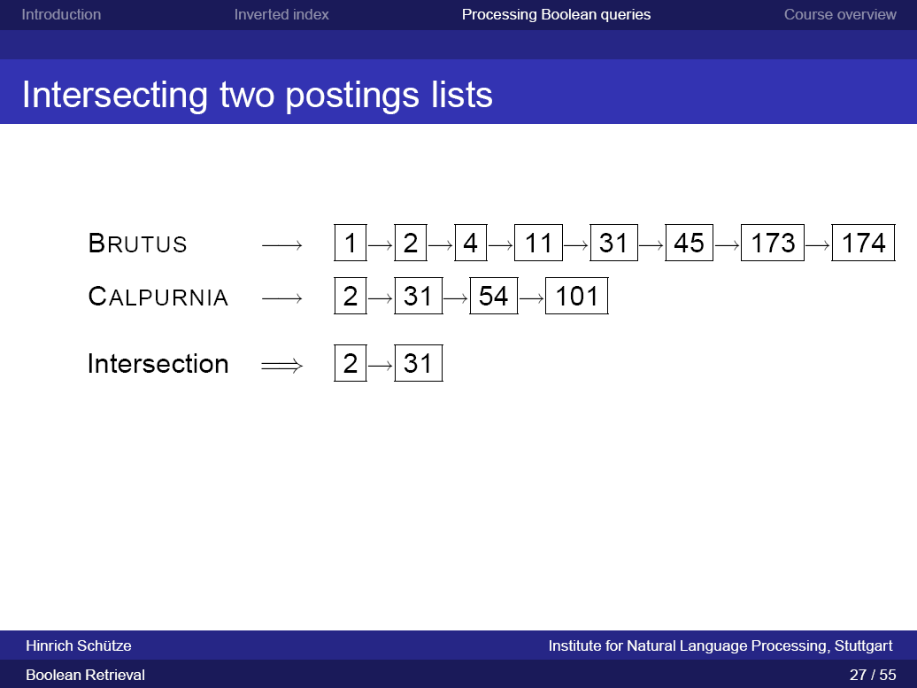

Slide 59
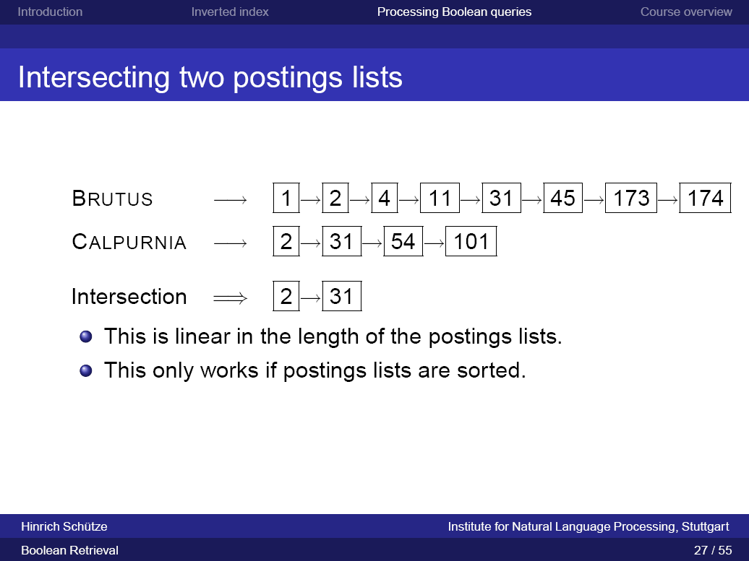

Slide 60


Slide 61


Slide 62


Slide 63


Slide 64


Slide 65


Slide 66


Slide 67


Slide 68


Slide 69


Slide 70


Slide 71


Slide 72


Slide 73


Slide 74


Slide 75


Slide 76


Slide 77


Slide 78


Slide 79


Slide 80


Slide 81


Slide 82


Slide 83


Slide 84


Slide 85


Slide 86


Slide 87


Slide 88


